Slide 1
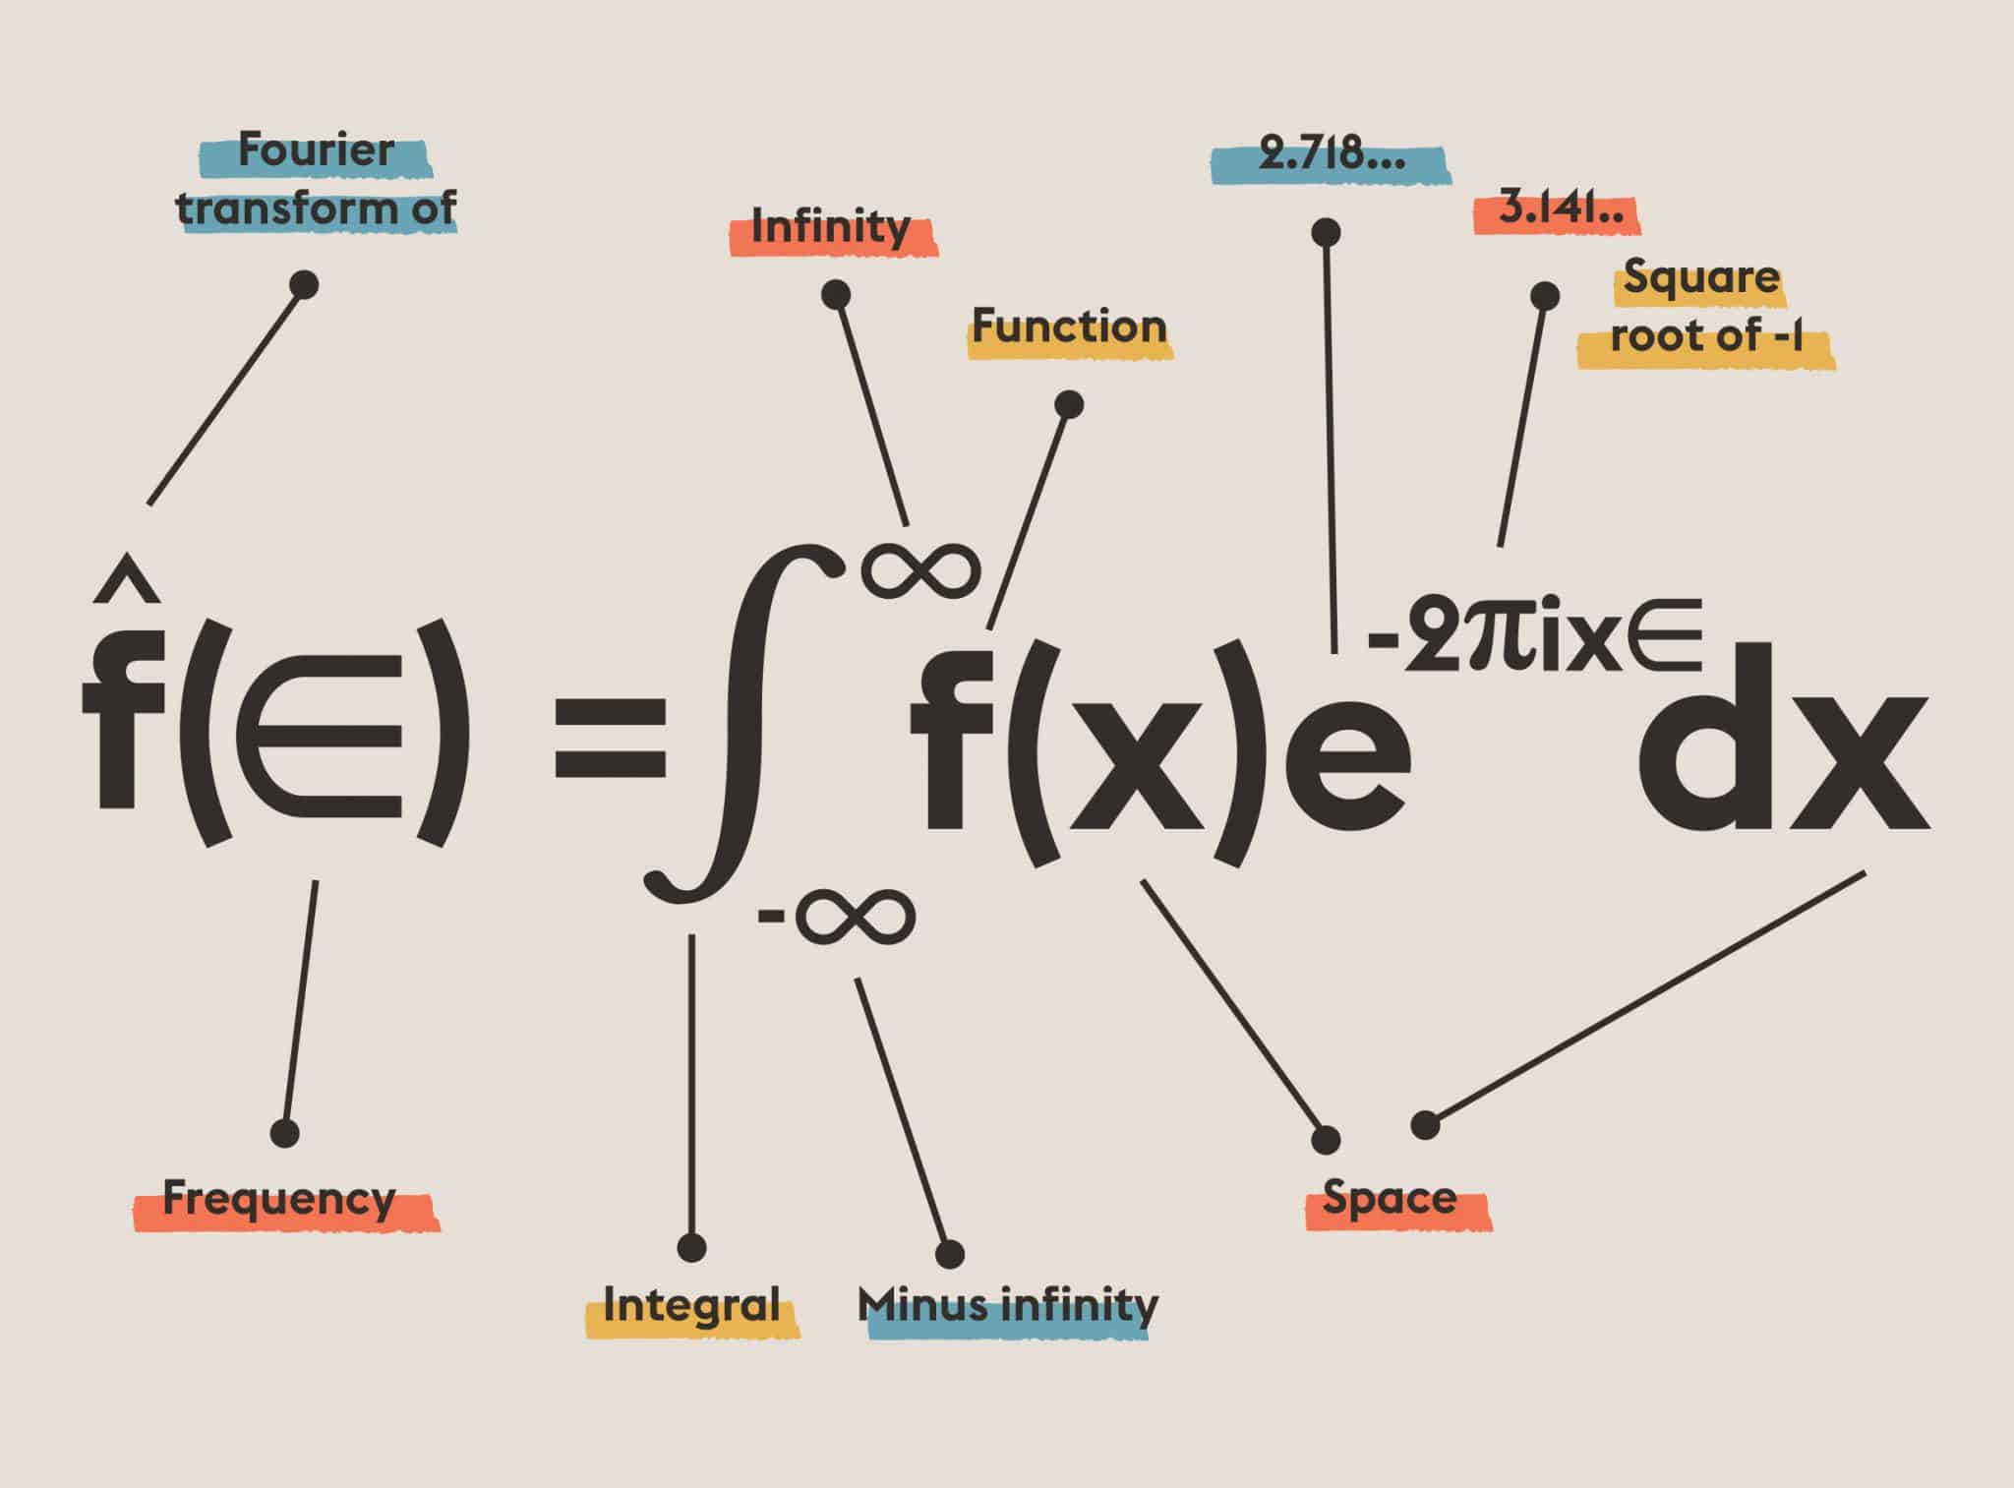
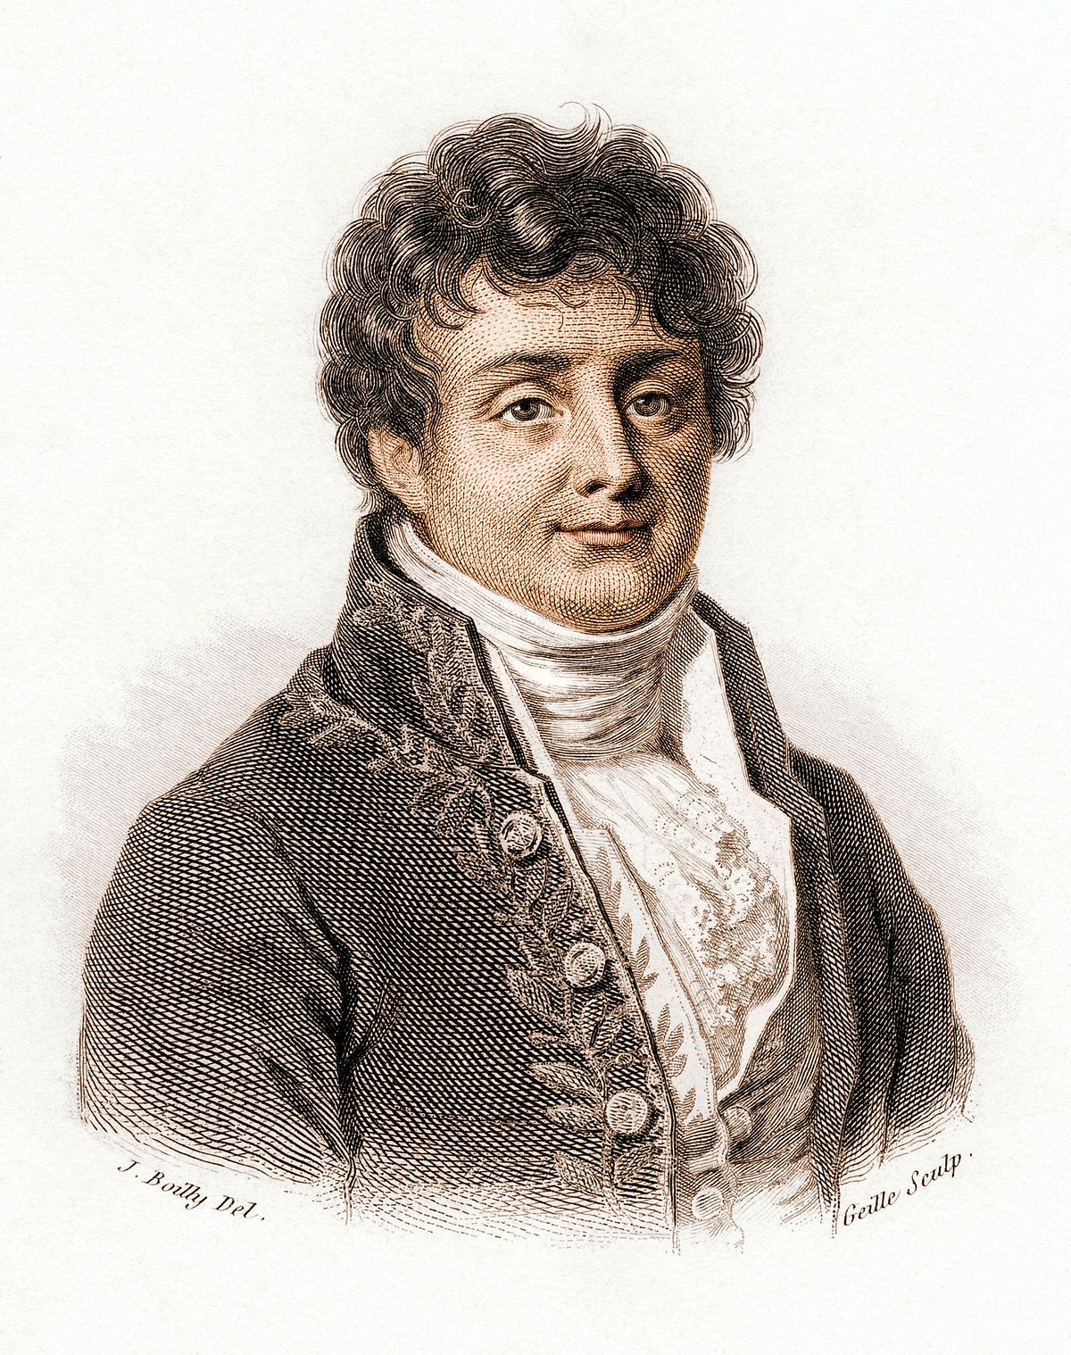
Fourier Transform for
Image Filtering
And
Frequency Domain Analysis
Jean Baptiste Joseph Fourier
Notes:
Image Reference: https://images.app.goo.gl/4NYPMFVt9onr1XkN6, https://images.app.goo.gl/bMTbdQr4pcj2iGEG9

Slide 2
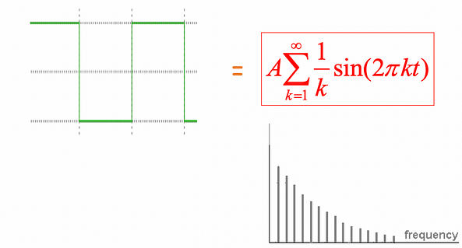
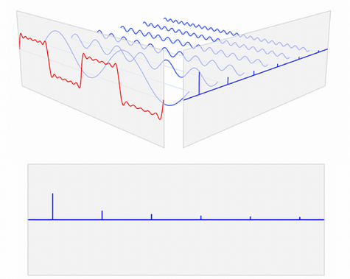
Fourier Theory:
Jean Baptiste Joseph Fourier
Jean Baptiste Joseph Fourier says any univariate function can be rewritten as a weighted sum of sines and cosines of different frequencies.
It is mostly true and called Fourier Series.
Fourier Theory
Any function that periodically repeats itself can be expressed as a sum of sines and cosines of different frequencies each multiplied by a different coefficient.
Notes:
Image Reference: https://medium.com/@gokcenazakyol/what-are-filtering-in-frequency-domain-and-fourier-transform-image-processing-5-6f4cace43c91

Slide 3
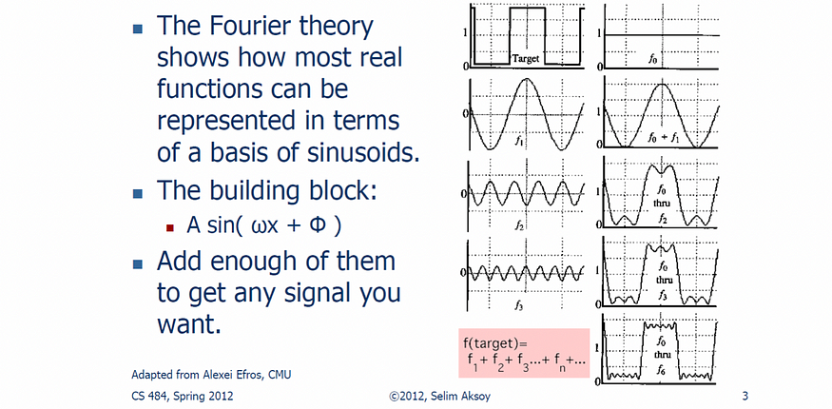
Notes:
Image Reference: https://medium.com/@gokcenazakyol/what-are-filtering-in-frequency-domain-and-fourier-transform-image-processing-5-6f4cace43c91

Slide 4
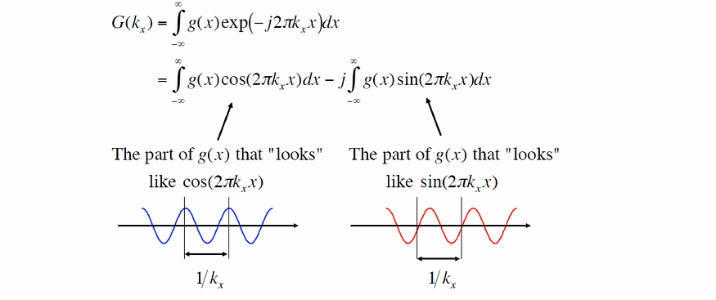
Fourier Transform:
The Fourier transform is a mathematical operation that transforms a signal from the time domain to the frequency domain.
1-D Fourier Transform: It is used to analyze signals in order to extract useful information, such as the frequency content of a signal.

Slide 5


Units:
Temporal Coordinates, e.g. t in seconds, f in cycles/second.
Spatial Coordinates, e.g. x in cm, k_{x} is spatial frequency in cycles/cm.

Slide 6
2-D Fourier Transform:
The 2D Fourier transform is an extension of the 1D Fourier transform, used to analyze two-dimensional signals, such as images.
Fourier Transform:
Inverse Fourier Transform:

Slide 7
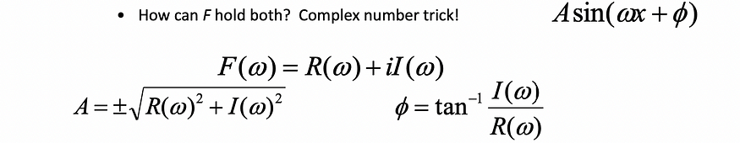
It is needed to be understand the frequency w of the signal. So, reparametrize the signal by w instead of x:
For every w from 0 to inf, F(w) holds the amplitude A and phase f of the corresponding sine.

Slide 8
Fourier transform stores the magnitude and phase at each frequency.
Magnitude encodes how much signal there is at a particular frequency.
Phase encodes spatial information (indirectly).
Fourier Transform can always be inversed.
Note: In the next subtopics, some of the sources used u for k_{x} and v for k_{y}.

Slide 9
Discrete Fourier Transform
Discrete Fourier Transform is used to analyze discrete signals, such as digital audio and images.
It decomposes a discrete signal into its individual frequency components, allowing for the analysis of the frequency content of the signal.

Slide 10
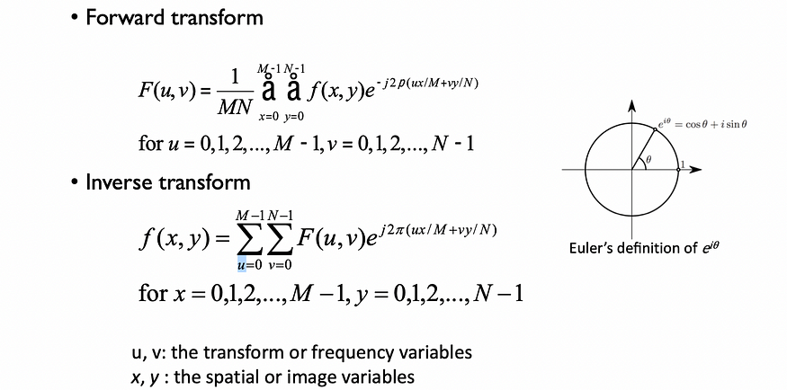

Slide 11
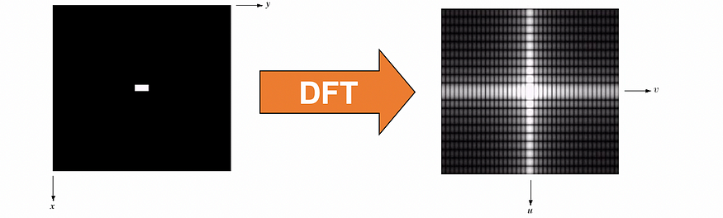
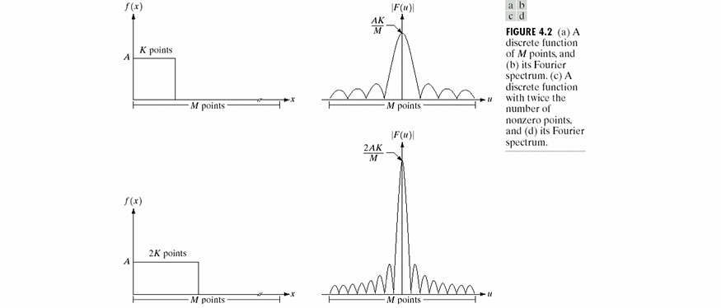
The DFT of a two dimensional image can be visualized by showing the spectrum of the images component frequencies:

Slide 12
Plane Waves:
Plane waves are a type of wave that propagate in a single direction and have the same amplitude and phase at all points along a given plane.
They can be described mathematically by a sinusoidal function, and are often used as a simplifying assumption in physics and engineering to represent more complex waves.

Slide 13
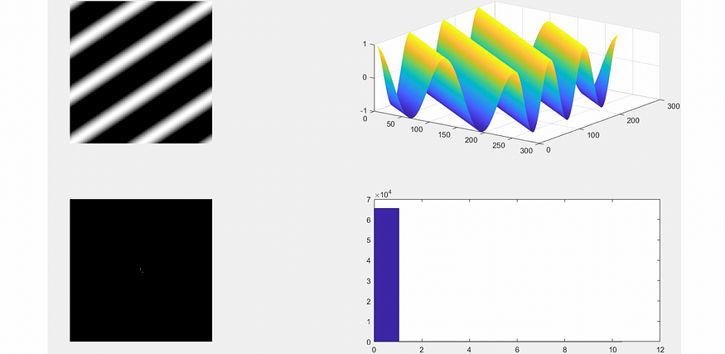
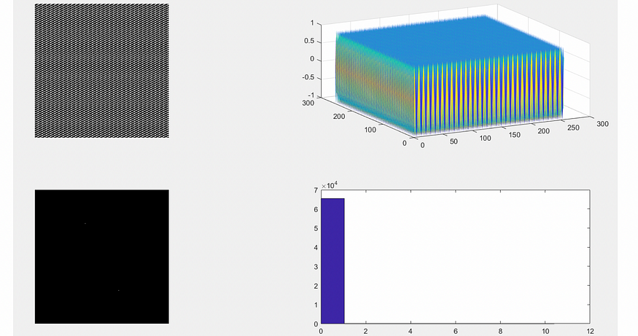
K_{x}= 2 K_{y}= 3
K_{x}= 32 K_{y}= 64

Slide 14
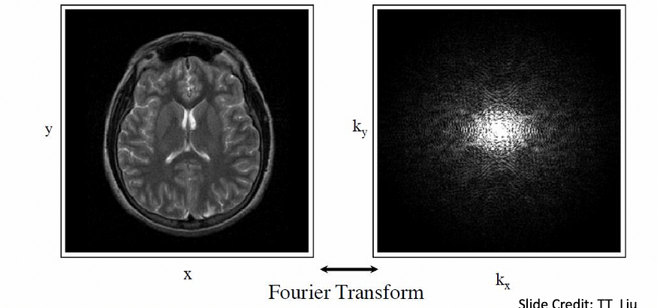
K-Space:

Slide 15
Fast Fourier Transform:
The fast Fourier transform (FFT) is an efficient algorithm for computing the discrete Fourier transform (DFT) of a sequence, or its inverse.
It can significantly reduce the computational complexity of the DFT, making it possible to perform the transformation on very long sequences in a relatively short amount of time.
If we take the 2-point DFT and 4-point DFT and generalize them to 8-point, 16-point, …, 2r-point, we get the FFT algorithm.
To compute the DFT of an N-point sequence using equation (1) would take O(N^2) multiplies and adds.
The FFT algorithm computes the DFT using O(N log N) multiplies and adds.
The FFT is also used for fast extended precision arithmetic (e.g. computing π to a zillion digits), and multiplication of high-degree polynomials, since they also involve convolution. If polynomials p and q have the form:

Slide 16
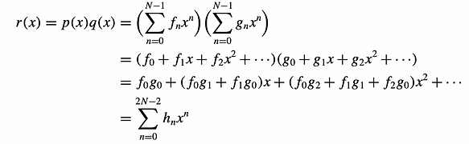
then their product is the polynomial:

Slide 17
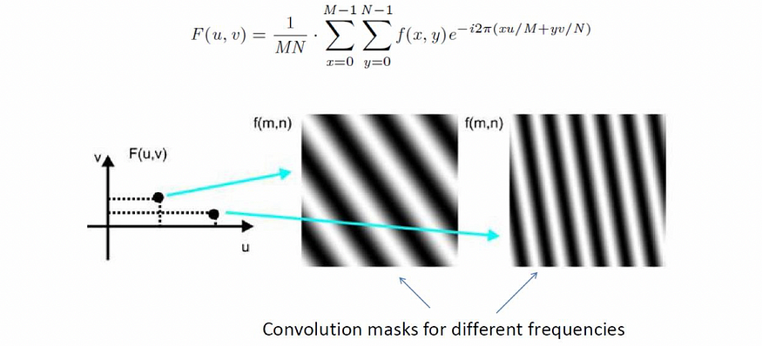
2D Fast Fourier Transform:

Slide 18
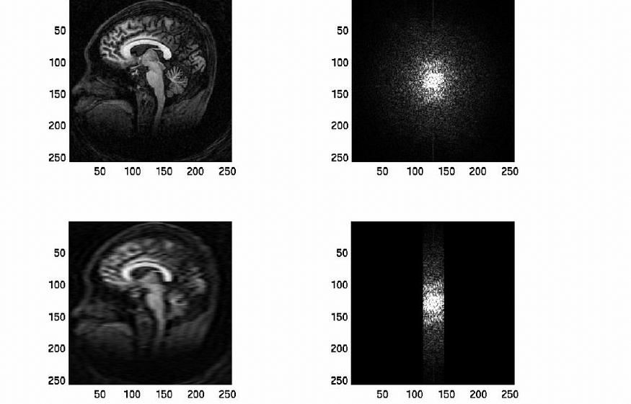
Some Examples are shown below:

Slide 19
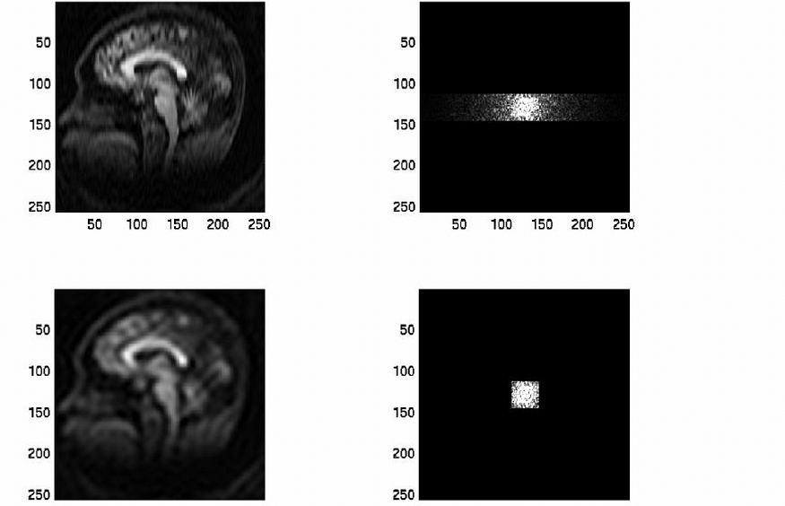

Slide 20
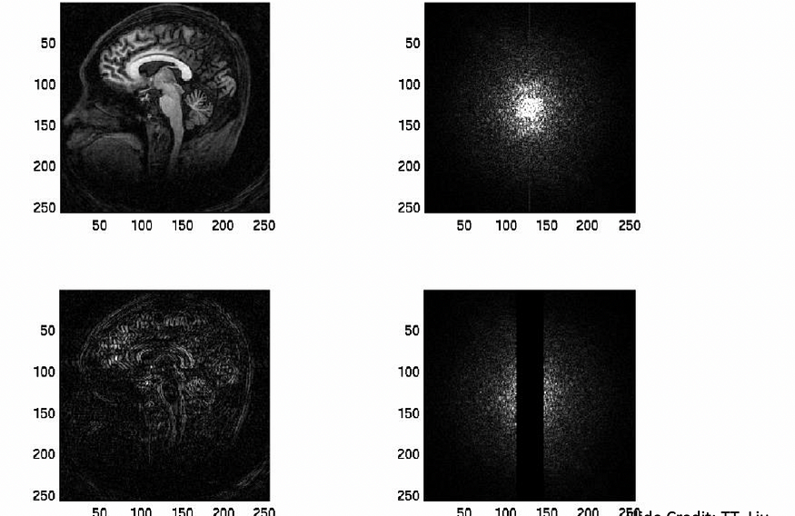

Slide 21
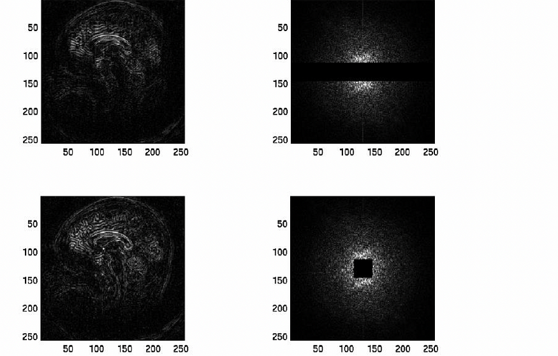

Slide 22
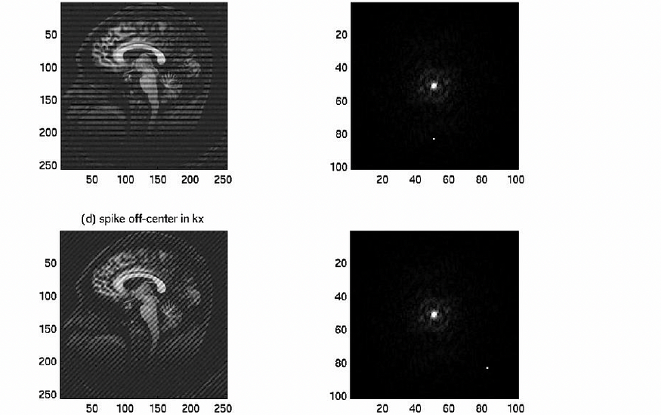

Slide 23
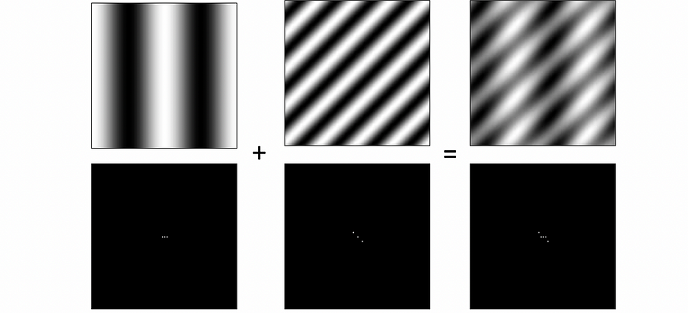
Fourier Analysis in Images:
Signals can be composed.

Slide 24
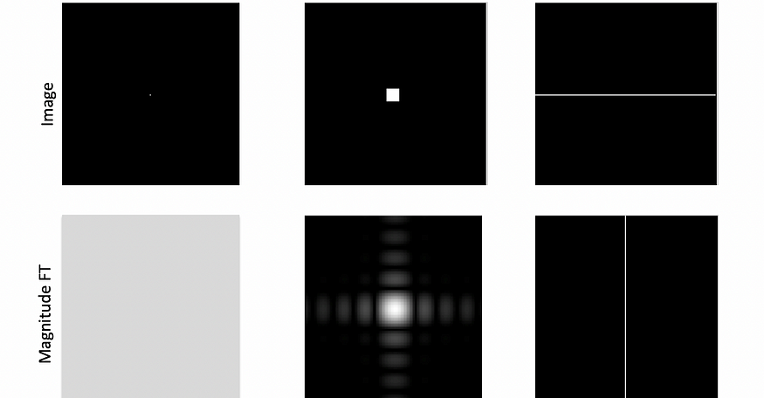
Some Important Fourier Transform:

Slide 25
The Convolution Theorem:
The Fourier transform of the convolution of two functions is the product of their Fourier transforms.
The inverse Fourier transform of the product of two Fourier transforms is the convolution of the two inverse Fourier transforms.
Convolution in spatial domain is equivalent to multiplication in frequency domain.

Slide 26
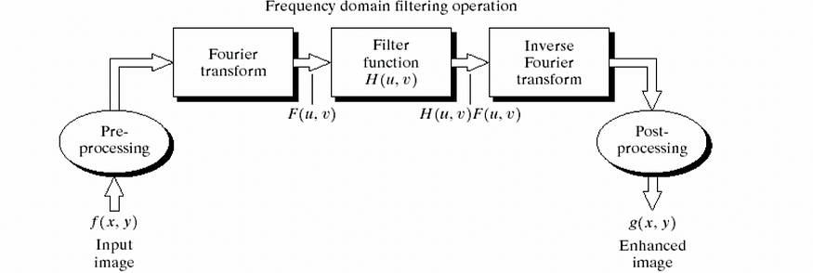
The DFT and Image Processing:

Slide 27
To filter an image in the frequency domain:
Compute F(u,v) the DFT of the image
Multiply F(u,v) by a filter function H(u,v)
Compute the inverse DFT of the result

Slide 28
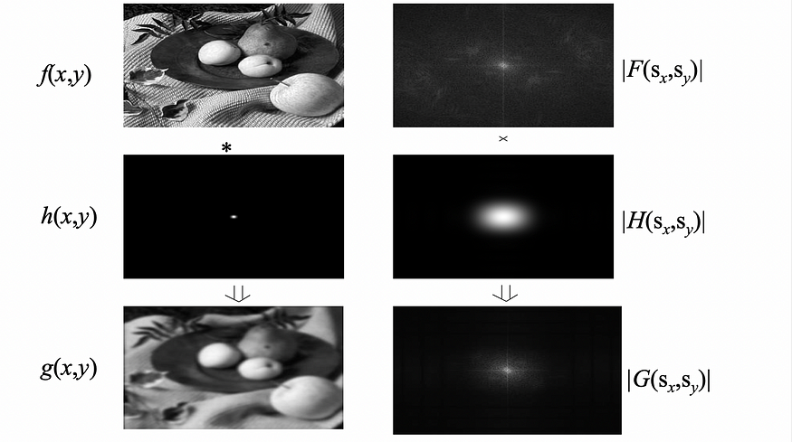
2D Convolution Theorem Example:

Slide 29
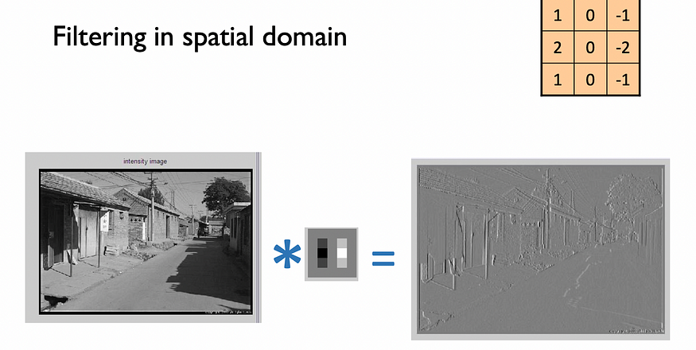

Slide 30
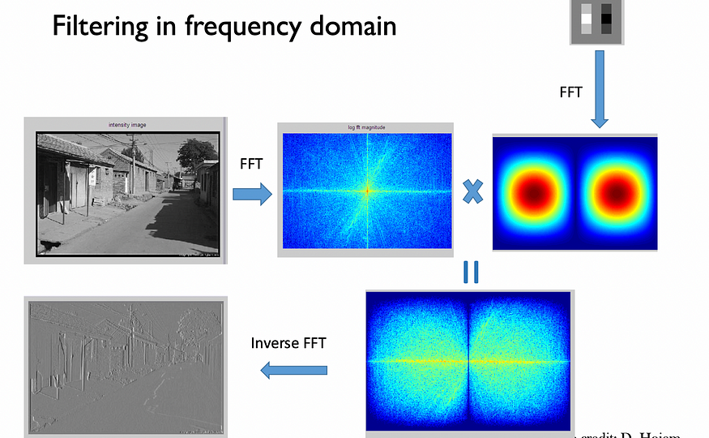

Slide 31
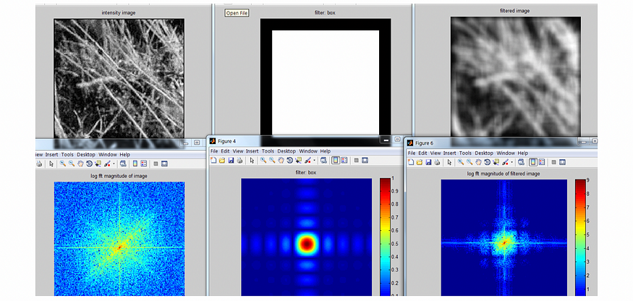
Box Filter

Slide 32
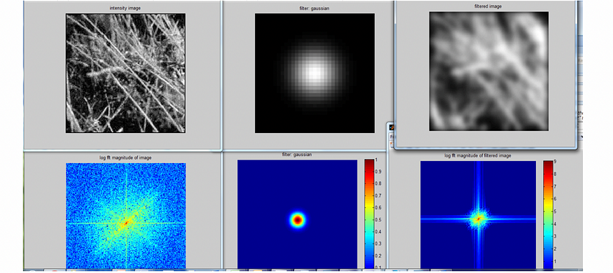
Gaussian Filter

Slide 33
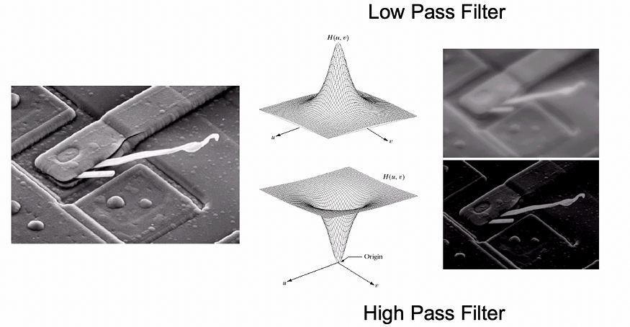
Some Basic Frequency Domain Filters:

Slide 34
Smoothing Frequency Domain Filters:
Smoothing is achieved in the frequency domain by dropping out the high frequency components.
The basic model for filtering is:
G(u,v) = H(u,v)F(u,v)
where,
F(u,v) is the Fourier transform of the image being filtered and
H(u,v) is the filter transform function.

Slide 35
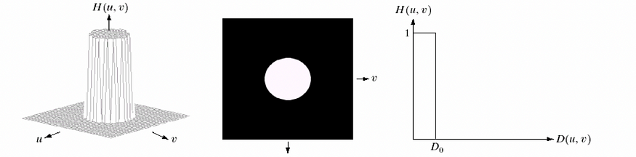

Ideal Low Pass Filter:
Low pass filters only pass the low frequencies, drop the high ones. Ideal low pass filters simply cut off all high frequency components that are a specified distance D0 from the origin of the transform.
The transfer function for the ideal low pass filter can be given as:

Slide 36
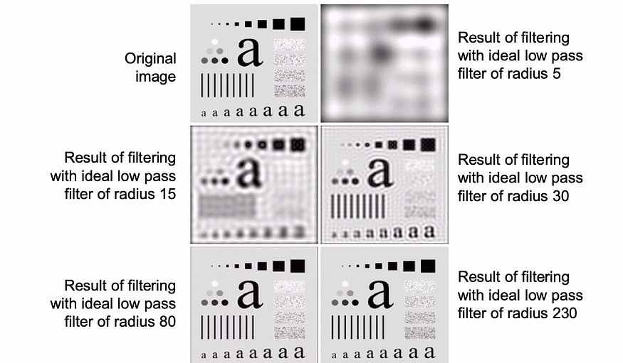
where D(u,v) is given as:

Slide 37
Low-pass, Band-pass, and High-pass Filters:
A band-pass filter is a type of filter that allows a certain range of frequencies to pass through while attenuating (reducing) frequencies outside of that range.
The range of frequencies that are passed through is called the passband.
A high-pass filter is a filter that passes high frequency signals while attenuating (reducing) low frequency signals.

Slide 38
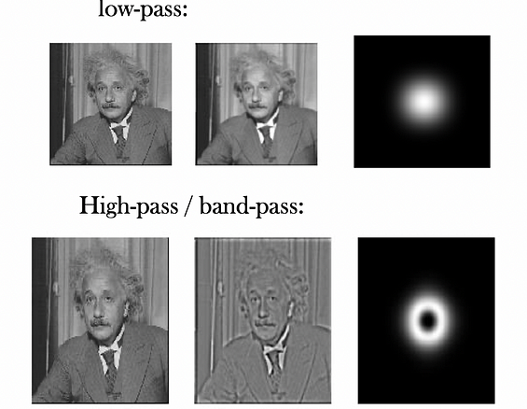

Slide 39
Frequency Domain Filtering & Spatial Domain Filtering:
Filtering in the spatial domain can be easier to understand.
Filtering in the frequency domain can be much faster — especially for large images.

Slide 40
References:
“Digital Image Processing”, Rafael C. Gonzalez & Richard E. Woods, Pearson/Prentice Hall, 2018.
“AIN430 Fundamentals of Image Processing”, Ali Seydi Keçeli
“Fourier Transforms and the Fast Fourier Transform (FFT) Algorithm”, Paul Heckbert
ChatGPT
https://medium.com/@gokcenazakyol/what-are-filtering-in-frequency-domain-and-fourier-transform-image-processing-5-6f4cace43c91

